Slide 1
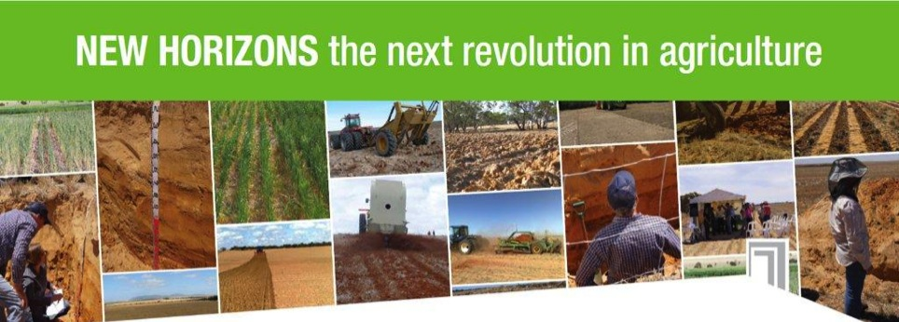

NEW HORIZONS the next revolution in agriculture
Creating New Horizons in old South Australian soils
New Horizons
Releasing the Productive Potential across 40% of South Australia
Notes:
The NH program has been widely advertised as program to boost the state economy
Has far wider application and implications than that
You only need to look at the name of the program to see that…
What’s an agricultural revolution
- an agronomic, or technology or mechanical advancement that led to a substantial increase in productivity

Slide 2

New Horizons: a Landcare journey
1 - A NRM and Agricultural problem
2 – Desire to fix the problem
3 – Experiments to fix the problem
4 – A solution to the problem because
People want to solve problems
But!!!
Is it the best solution for the worst problem??
Notes:
Like most human activity systems there is a process of what, where, how, when and who

Slide 3

Why do we need another
REVOLUTION in AGRICULTURE?
‘PEAK’ everything – land, water, oil, R&D
Competition for land and water use
Changing climate
Increasing input costs (and losses!)
Increasing pressure to reduce emissions and store more carbon
Global food demand
  9.6 – 9.7 billion by 2050 – food up 70%
Notes:
Losing 12 million ha /year to desertification and urbanisation
Mining, coal seam gas, urban expansion
Longer hotter summers and more intense rainfall systems
Fuel to fertiliser to chemical the costs are going up machinery
Agriculture contributes 16% of GHG emissions and biggest emitter of N20 >70% and methane at >60%
Other industries working to reduce theirs, we need to reduce ours too
On top of these limitations
INCREASING DEMAND FOR FOOD
And especially for meat and milk derived protein
These people will be more wealthy and more fussy about where their food came from and how it was produced

Slide 4
What have we done in the past?
Previous revolutions
  Fertilisers
  Breeding and genetic modification
  Herbicides
  Rotations
  Machinery and technology developments
Which has resulted in…

Slide 5
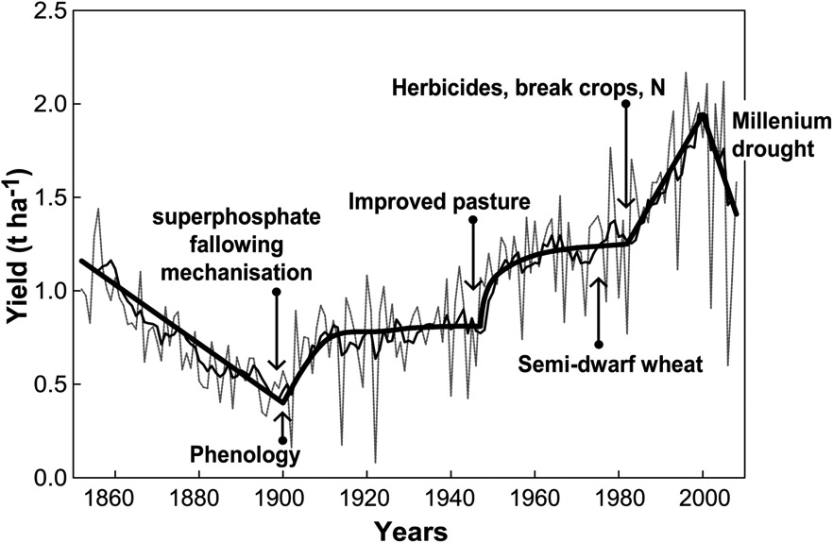
2b
3b
4b
5b
6b
Figure 1. Trends in Australian average annual wheat yields (line) and 10 year moving average (bold).
(J. A. Kirkegaard, and J. R. Hunt J. 2010)
Notes:
On average 1.1% increase per annum in yield, 0.6% attributed to breeding and 0.5% attributed to agronomy
Cracked 7 billion in 2011
Current 7.36 billion
Popn increases by over 200,000 a day
1.4 billion in china
1.3 billion in india
23 million in aus
In the next 35 years, we need at least 2% increase in production per year

Slide 6
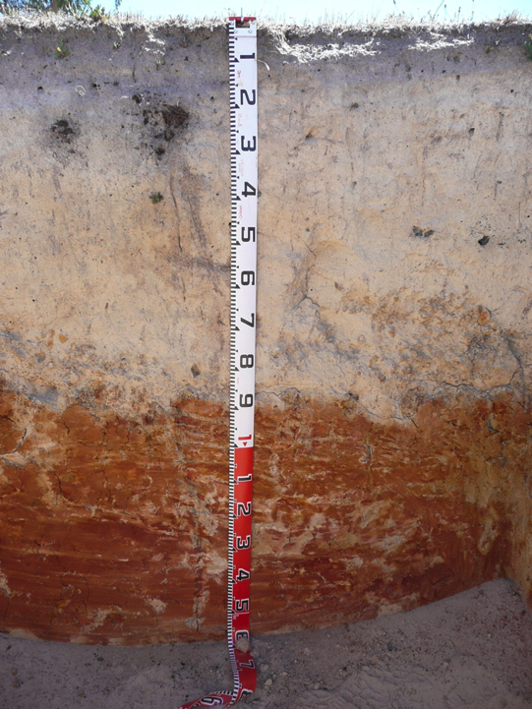
South Australian soils are old and largely worn out
Duplex soils – characterised by major change in texture
Deep sand over clay
New Horizons
Cadgee Site
Increasing age
Increasingly Duplex

Slide 7
ISSUES WITH Sandy Soils
Non-wetting
Low inherent fertility
Poor water holding capacity
Subsoil compaction
Prone to wind erosion
Low production + Difficult management
=
Notes:
Pain in the proverbial

Slide 8
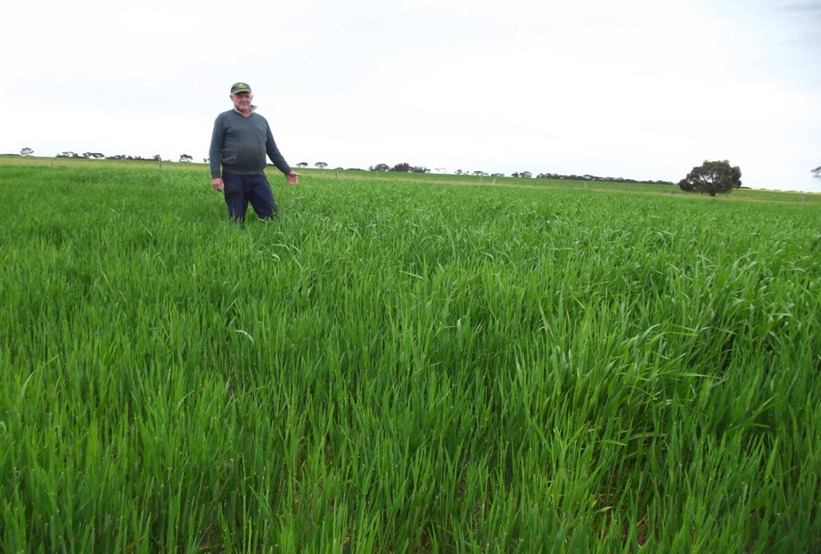
Community Leaders and Innovators
Roger Groocock
In the 1970’s Clem Obst applied clay to sandy soils to solve non-wetting

Slide 9
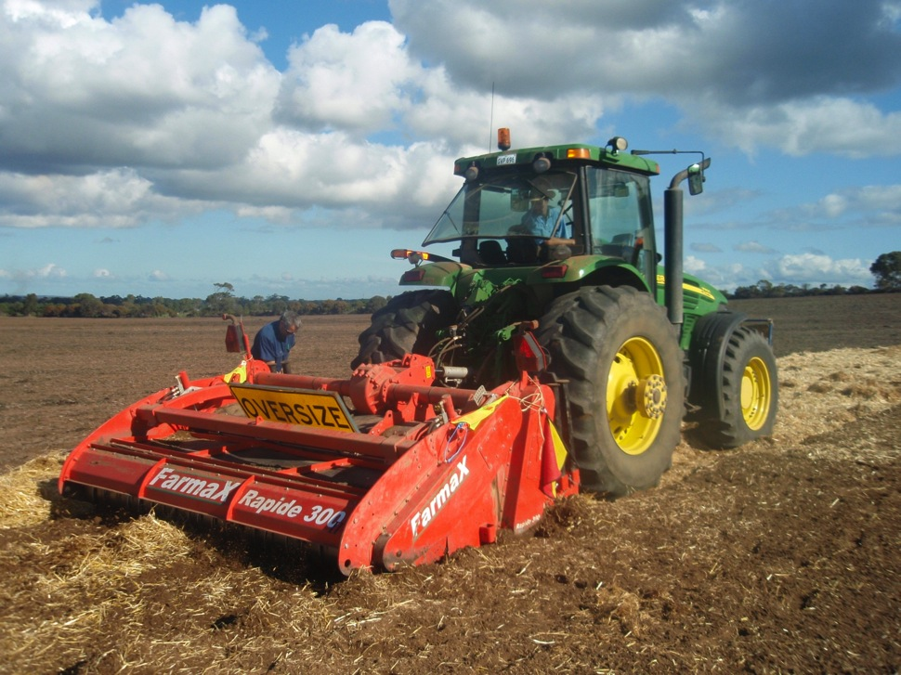
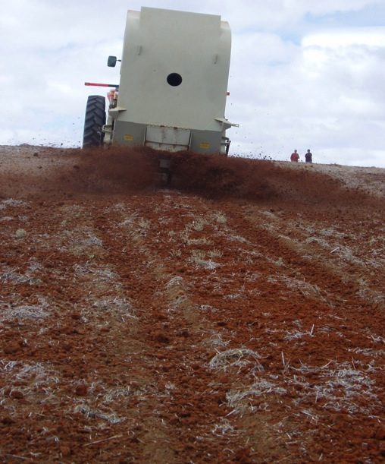
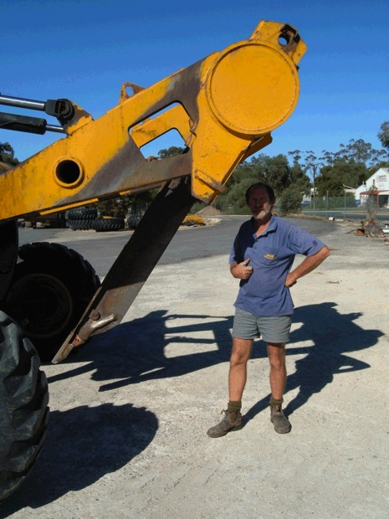
Machinery has evolved from awareness but is also a catalyst for further experimentation
Needed to incorporate clay deeper - spaders
Need to undertake at broad acre scale - Clay spreaders
Need to find cheaper sources of clay - Delvers
Spaders
Notes:
Need to undertake clay application at a broadacre scale - commercial machinery
Need to source cheaper clay – Delving
Delving - increased awareness of benefits of deep clay incorporation
Deep clay incorporation - Increased awareness of subsoil constraints
Awareness of subsoil constraints - need for machinery with better mixing capacity (spaders)
Spading increased awareness of opportunity to incorporate other amendments

Slide 10
The original game has changed!
Responding to an issue
Responding to a number of issues
Identifying and developing opportunities to deliver even better results
Increasing
complexity = increased understanding required
Gone from reaction to strategic development - Enter: New Horizons

Slide 11
Opportunities
Area
2.7 million ha of sandy soils under agricultural production
1.5 million ha of sodic or poorly structure subsoils
Theoretical Potential
One Billion $ increase in food production (based on 20% increase in WUE)
200 M tonnes of CO2-e
Reduction in soil erosion potential across 2 million ha
To support uptake - New Horizons:
Science to understand the processes
Trials to understand how to achieve results consistently
Engineering to improve machinery design
Demonstration and extension
Aim for broad-scale, rapid change in investment and practice

Slide 12
Proof of Concept
$2m over three years
Proof of concept
  Demonstrate we can double yield
  Identify the key knowledge gaps for larger program
  Build community interest
Three sites developed with Farming System Groups
  SE (MacKillip), Mallee (MSF), EP (LEADA)
Social survey of current practice and what it would take for farmers to change practice

Slide 13
Trials
12 treatments x 3 sites
5 replicates per treatment (4 at Brimpton Lake)
4 m x 25 m plots
  Clay – shallow or mixed (spaded)
  OM – Lucerne hay (not ideal from a $ perspective)
  Nutrients – banded or mixed
Very wet start to season
Very dry finish
Frost

Slide 14
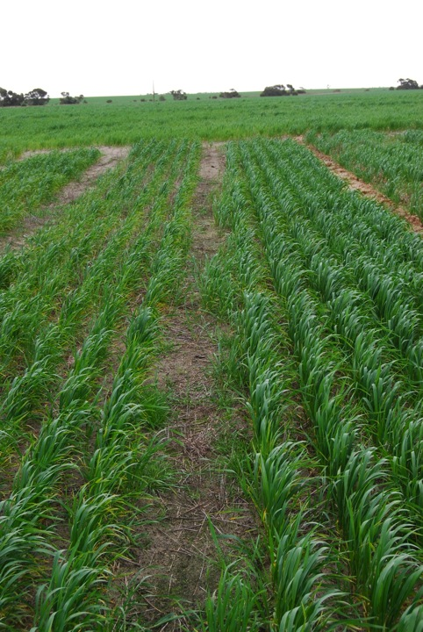
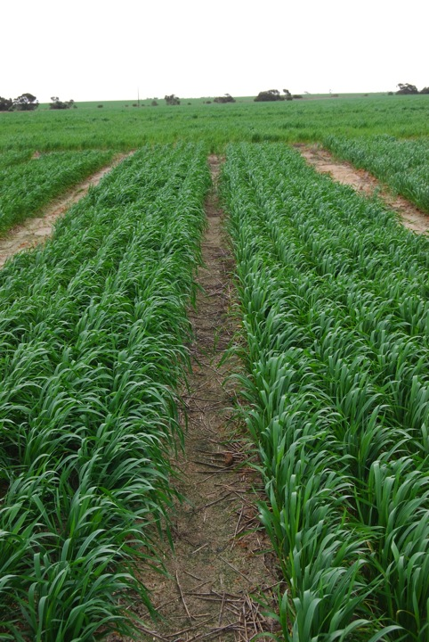
Clay + OM + Nutrition
Control
Notes:
Brimpton Lake 2015

Slide 15
Results
Affects of non-wetting vary across the three sites
All sites show earlier emergence and greater vigour on clayed sites to unclayed sites
Shallow clay incorporation affected emergence on some sites
All sites show a response to organic matter although we do not know if this is a nutritional response or related to some other factor
Yield on all sites – best treatments 2-2.5 times “best district practice”

Slide 16
Where to now?
Confirm longevity of yield increases - run trial sites for at least another 2 years
Develop trials on sodic/poorly structured soils
Determine best practice and most cost effective treatments – may require some more detailed experiments
Determine if increasing soil organic carbon through soil modification can gain access to Federal Government Emissions Reduction Fund (ERF)
Implement a suitable extension program

Slide 17
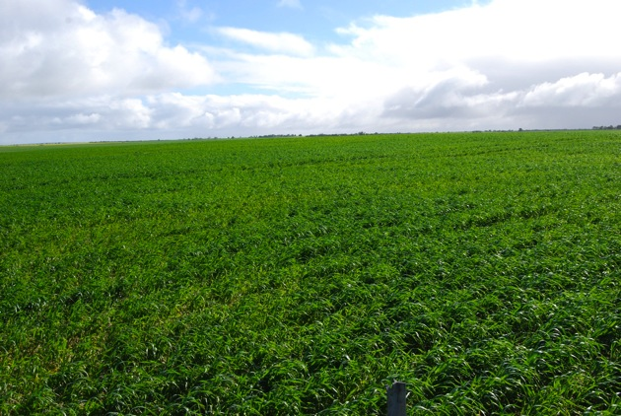
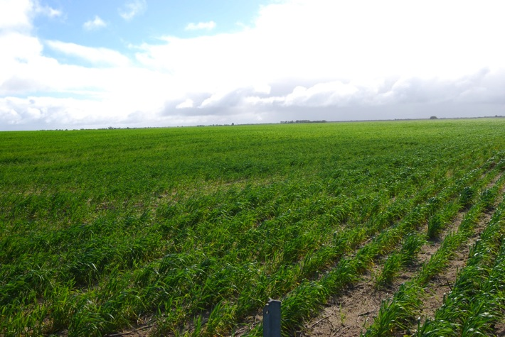
Farmer Adoption – already happening

Slide 18
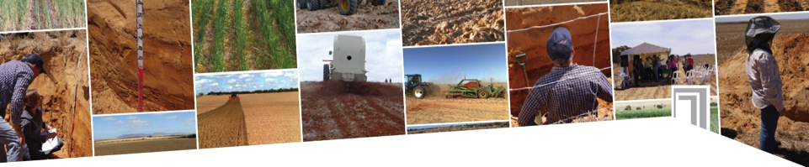





Program Partners

